Slide 1

Bayes Inference of Exponential Degree Distribution Complex Network
Pleader: Deqiang Zou

Slide 2
01
Introduction
02
Process
CONTENTS
03
Difficulties
04
Prospective
05
References

Slide 3

Part.1
Introduction

Slide 4
Introduction
Process
Difficulties
Prospective
References
1.1 Introduction
A.
Degree of complex networks is an important magnitude. With the knowledge of degree distribution, it literally presents the panorama of targets which improve efficiency of analysis on problem.
B.
Graph Theory is gradually going to be the hot pot for complex networks, as tools which shows pretty laws to study complex networks.
C.
Generalized Random Graph is a good derivative of graph theory, which introduces weight considered as tendency of connecting among vertices, much like the concept of degree.
Example：North America Power Grid Network(NAPGN)，during 2003, it consistently experienced a series of blackouts which resulted in a huge economic loss. Electrical Engineer studied electric transmission through topology of power grid networks, and then lower crisis of cascading power failure with strategies to average the electric burden. On the other hand, propose strategies to deal with energy emergency.
Notes:
(a)通过估计出复杂网络的度分布，可以帮助研究者从整体上把握目标对象，实现对问题的协同分析和集成分析，快速、准确地发现事物之间的联系，提高分析问题的效率

Slide 5
Introduction
Process
Difficulties
Prospective
References
1.2 Related works
Linear fitting to logarithmically binned histograms；
Direct linear fit of the X-log plot of the full raw histogram of the data;
Initial 5 points of the X-log plot of the raw histogram;
Before 2003
Related work
MLE + KS table (Introduced);
MLE + Truncate + KS (hot);
Derivatives
2004~2015
Recent Years
Graph Theory: Edge Adding, Edge Deleting, None-Balanced Theory, etc.

Slide 6
Introduction
Process
Difficulties
Prospective
References
1.3 Main Work
1
Mathematics Modeling with Generalized Random Graph
2
Bayes Inference with Markov Chain Monte Carlo
3
Simulations + Real World Complex Networks
4
KS-Test + Compared
Notes:
Results: 结合随机图论，回归复杂网络发展本身，把握当前研究趋势；修正当前主流研究方法的不足：独立性+数据利用率; 模型参数估计方法在准确度上超过主流方法;

Slide 7
Part.2
Process

Slide 8
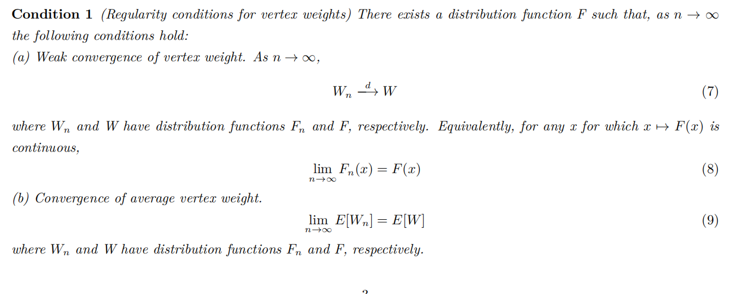
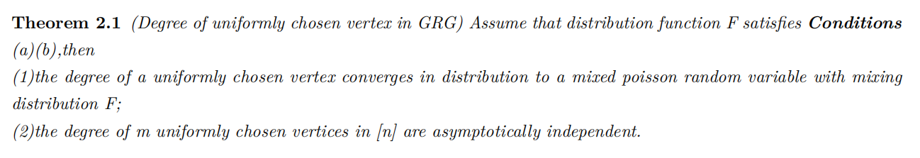
Introduction
Process
Difficulties
Prospective
References
2.1 Mathematics Modeling
Main References
Notes:
(1) 使用广义随机图理论为框架建模一个度分布为指数型的复杂网络，引入理论且作流程证明，捕捉指数型度分布网络模型参数的衍化过程;
(2)使用广义随机图理论为框架建模一个度分布为指数型的复杂网络，引入理论且作流程证明，捕捉指数型度分布网络模型参数的衍化过程;

Slide 9
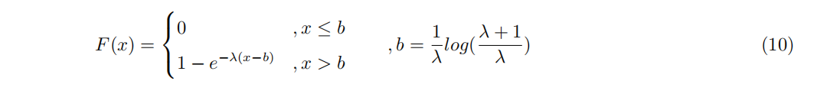
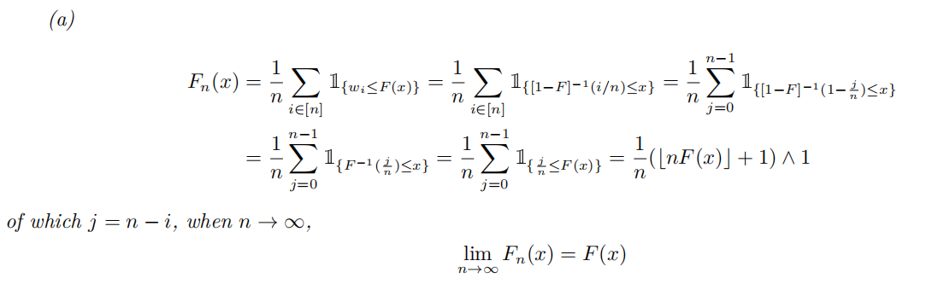

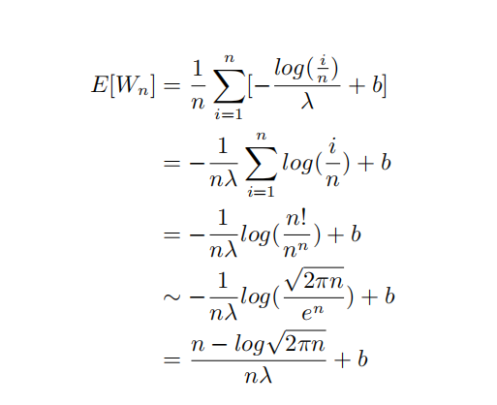
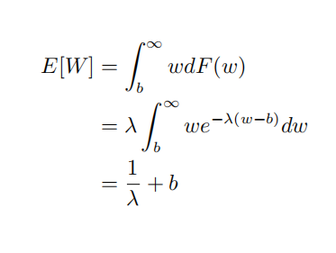
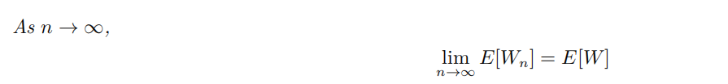
Introduction
Process
Difficulties
Prospective
References
2.1 Mathematics Modeling
The distribution of vertices’ weights

Slide 10
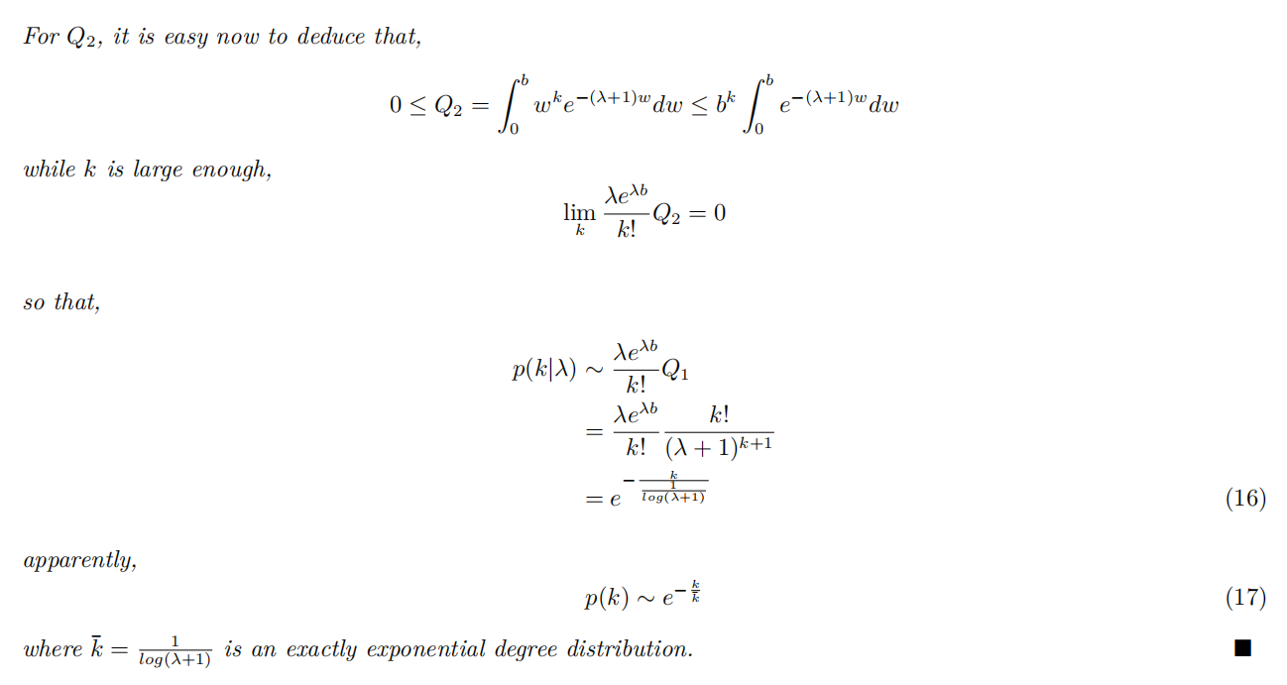
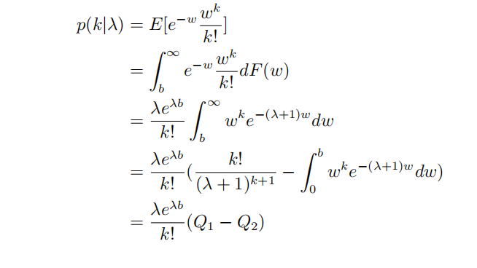
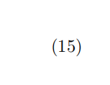
Introduction
Process
Difficulties
Prospective
References
2.1 Mathematics Modeling

Slide 11
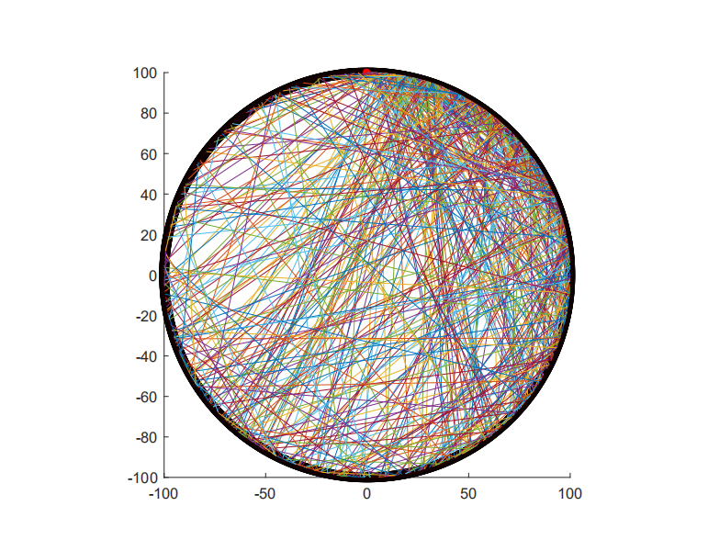
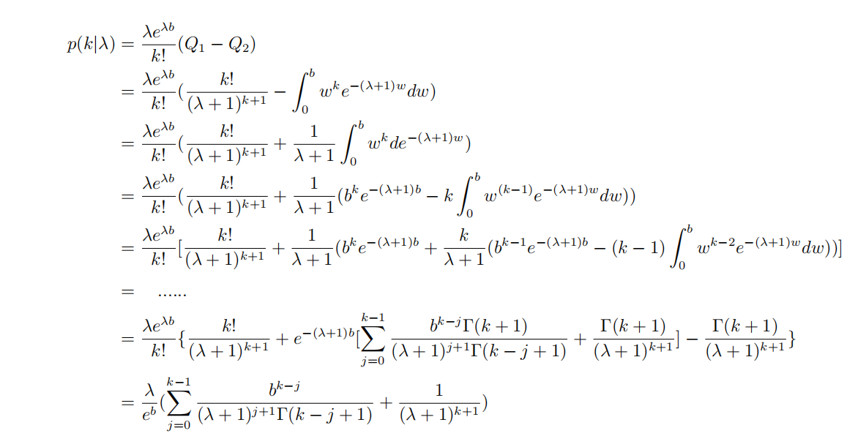
Introduction
Process
Difficulties
Prospective
References
2.1 Mathematics Modeling

Slide 12
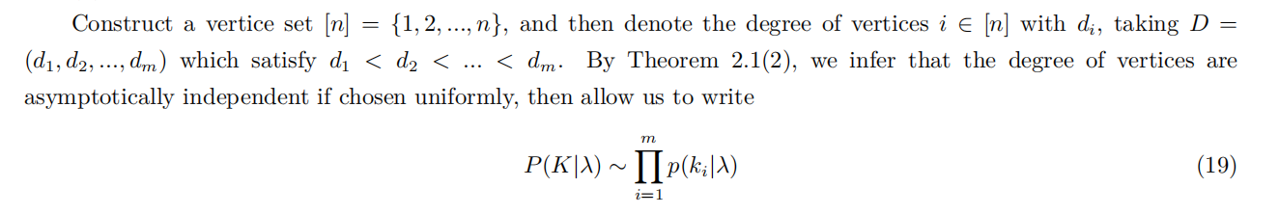
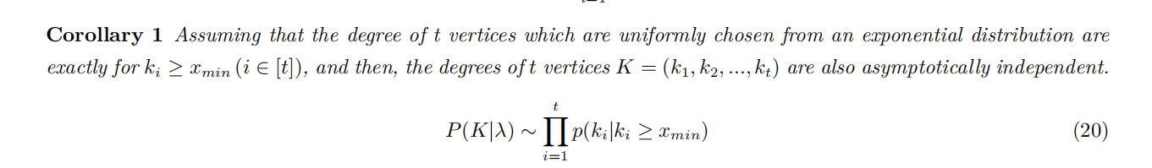
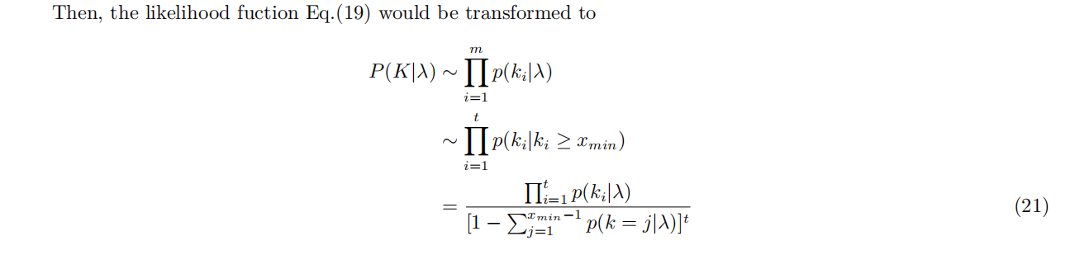
Introduction
Process
Difficulties
Prospective
References
2.2 Bayes Inference with MCMC

Slide 13
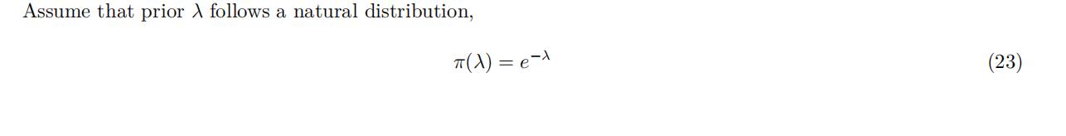
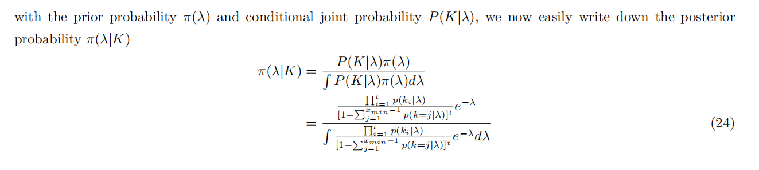
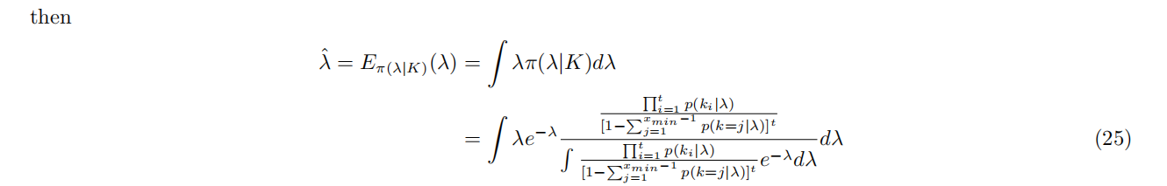
Introduction
Process
Difficulties
Prospective
References
2.2 Bayes Inference with MCMC
Markov Chain Monte Carlo

Slide 14
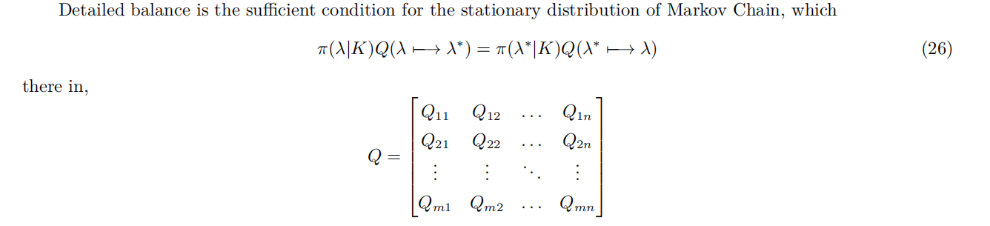
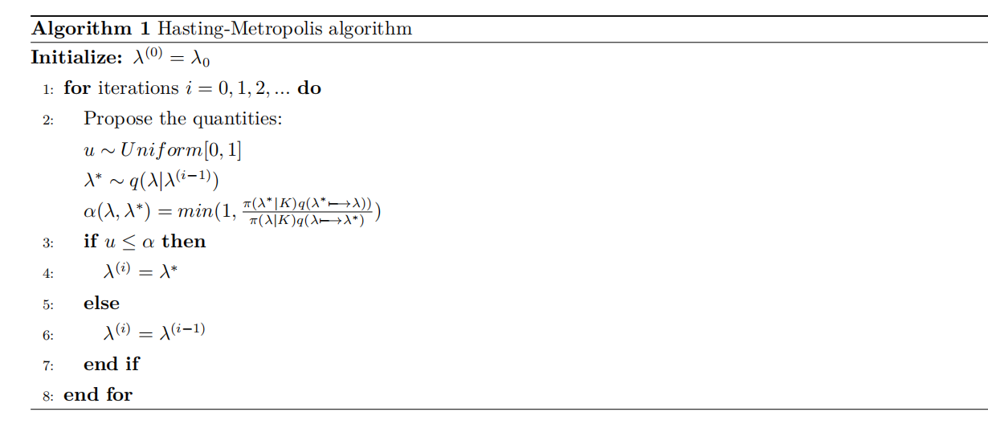
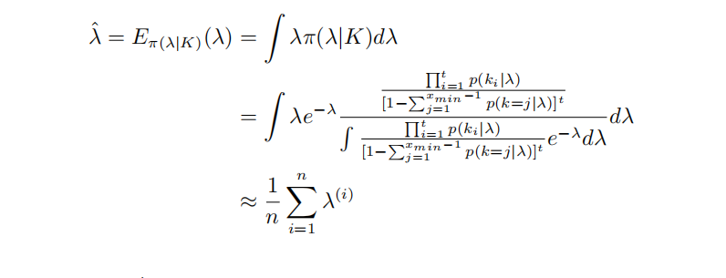
Introduction
Process
Difficulties
Prospective
References
2.2 Bayes Inference with MCMC

Slide 15
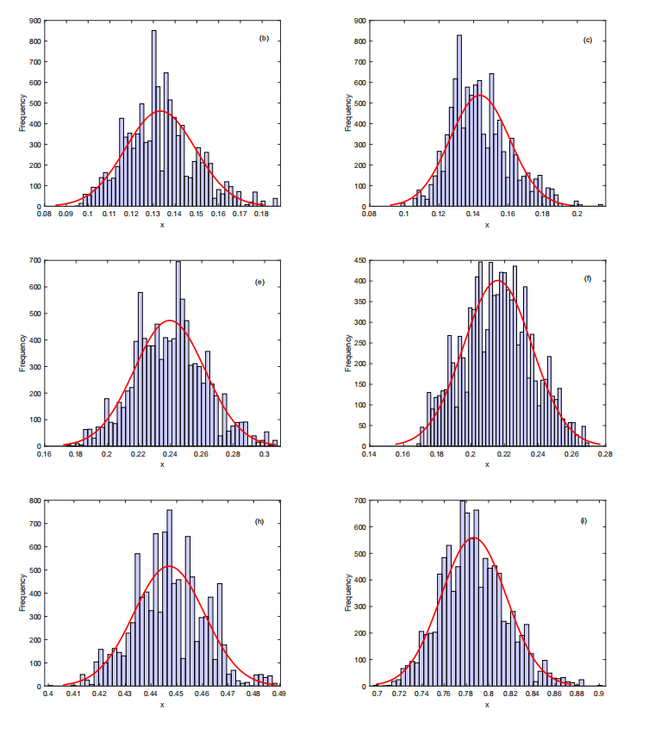
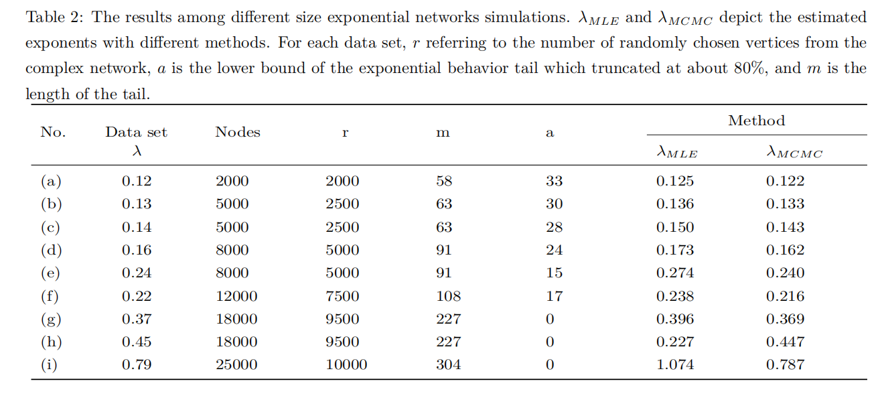
Introduction
Process
Difficulties
Prospective
References
2.3 Simulations + Real World Complex Networks

Slide 16
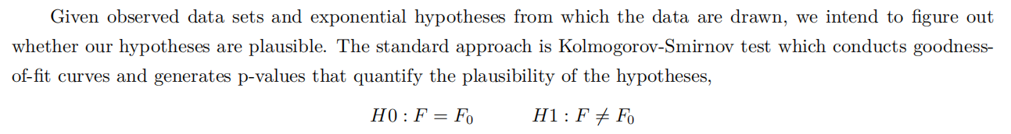
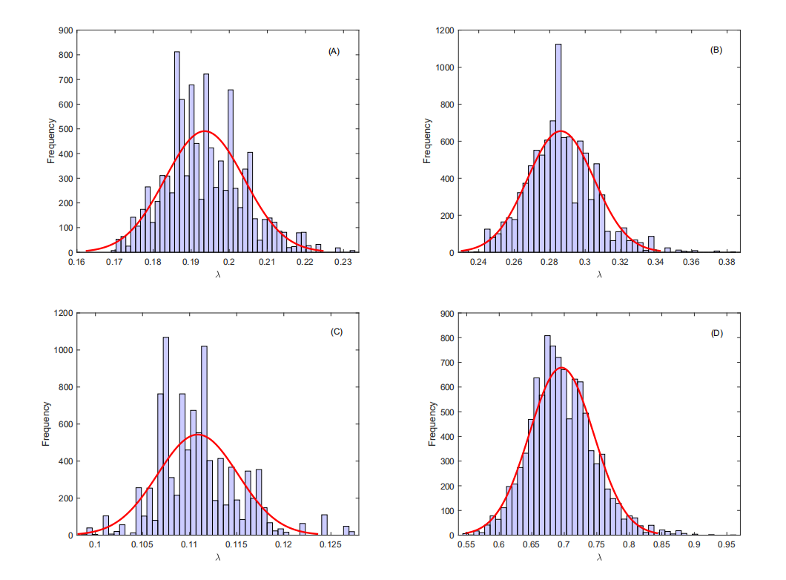
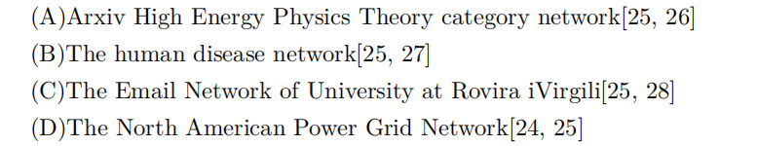
Introduction
Process
Difficulties
Prospective
References
2.3 Simulations + Real World Complex Networks

Slide 17
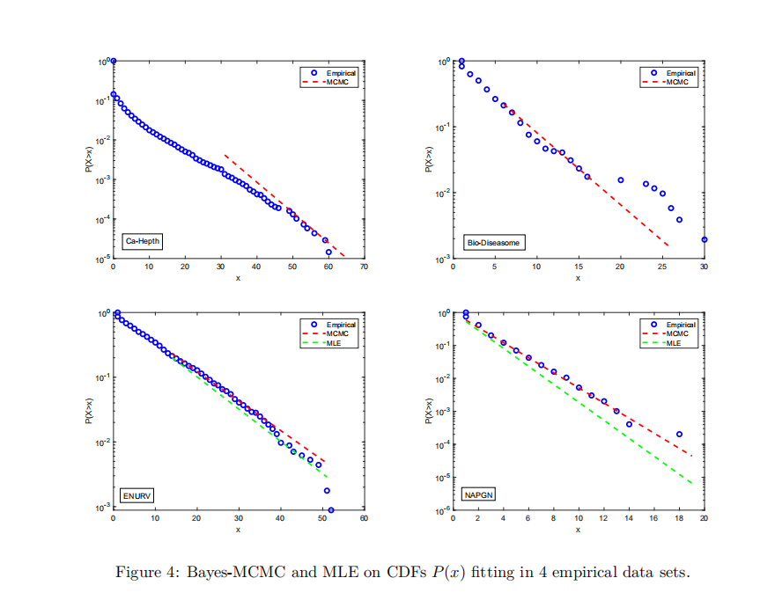
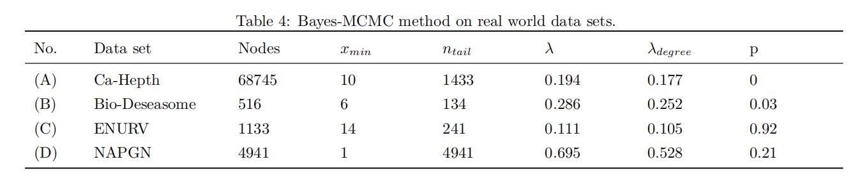
Introduction
Process
Difficulties
Prospective
References
2.4 KS-Test + Compared
Notes:
Based on the results, we account for the exponential models are great fitting to the data sets (C)(D), simultaneously
meaning that the degree of complex networks follow the exponential, but not (A)(B). Although not enough evidence
for exactly exponential, we just find the graphics of Ca-Hepth and Bio-Dieasome exhibit the exponential-like degree
distribution, may be as references.

Slide 18
Part.03
Difficulties

Slide 19
Introduction
Process
Difficulties
Prospective
References
3.1 Difficulties
a.
The choice of weights’ distribution of vertices is a complicated work, and it has to be adjusted on details of bias or what else, to proving that subsequent deduction is reasonable. Obviously, they are uneasily controlled.
b.
In practical, the results deviated from our thinking several times, such as computation exploding, muti-phase parameters estimation, none-pass of KS-Test, etc, they deserved much more experiments to explain which costs huge time in this background.

Slide 20
Part.05
Prospective

Slide 21
Introduction
Process
Difficulties
Prospective
References
4.1 Prospective
Anomaly Detection：
Based on this mathematics model, complex system is supposed to hold an anomaly detection function after setting threshold of exponent, or interacting with machine learning, and leave a health surveillance of current complex system.
1
Optimization：
For any complex system, like power grid, there is an optimization span of efficiency of power transmission. Only if got enough data, we may capture the optimal degree information and then conduct the design of connection among power stations to optimize networks.
2

Slide 22
Thanks!
Pleader：Deqiang Zou

Slide 23
Introduction
Process
Difficulties
Prospective
References
5.1 References
Broido A D, Clauset A. Scale-free networks are rare[J]. Nature Communications, 2019, 10(1):1017-1027.
Goldstein M L, Morris S A, Yen G G. Problems with fitting to the power-law distribution[J]. The European Physical Journal B, 2004, 41(2):255-258.
Clauset A, Shalizi C R, Newman M E J. Power-law distributions in empirical data[J]. SIAM Review, 2009, 51(4):661-703.
Van Der Hofstad R. Random graphs and complex networks: volume 1[M]. [S.l.: s.n.], 2016: 181-201.
Rossi R A, Ahmed N K. The network data repository with interactive graph analytics and visualization[C/OL]//AAAI. 2015. http://networkrepository.com.
Watts D J, Strogatz S H. Collective dynamics of ’small-world’ networks[J]. Nature, 1998, 393(6684):440-442.
Barab´asi A L, Albert R. Emergence of scaling in random networks[J]. Science (American Association for the Advancement of Science), 1999, 286(5439):509-512.

